Slide 1

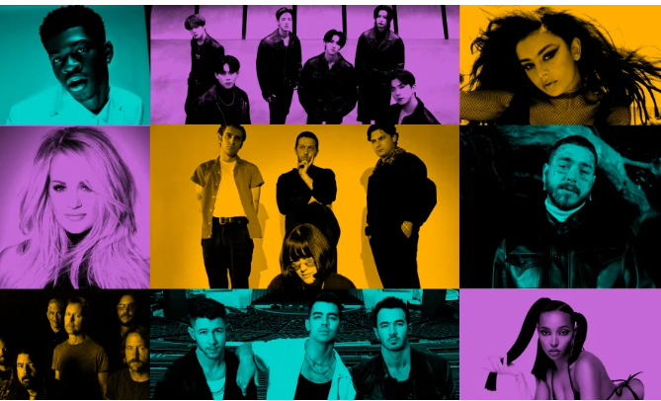

Final project on music platform bandsintown
ITC 6000
Presentation Slides by Sean McLean

Slide 2

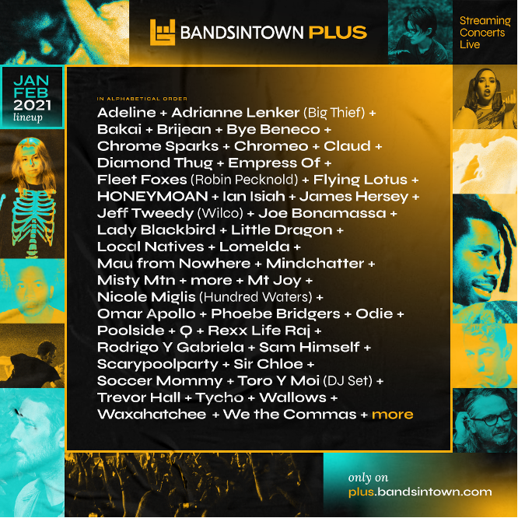

Overview Of The Challenge
The goal is to examine the platform's user features and enhance recommendation systems to personalize search histories, leading to optimal concert, artist, venue, and event suggestions.
Addressing this business challenge involves analyzing user tracking system requirements and constructing a comprehensive one-stop experience for discovering and purchasing concert tickets.

Slide 3



User Personna's of the Platform
Music Streamers
Concert Goers
Artist Followers

Slide 4

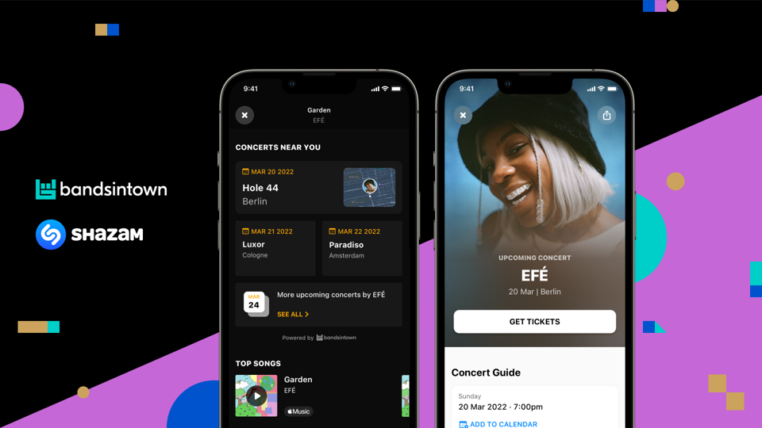
Business rules
Required User Account
User Experience
Recommendation Systems
Geographic Awareness
Community Values
Inclusivity

Slide 5
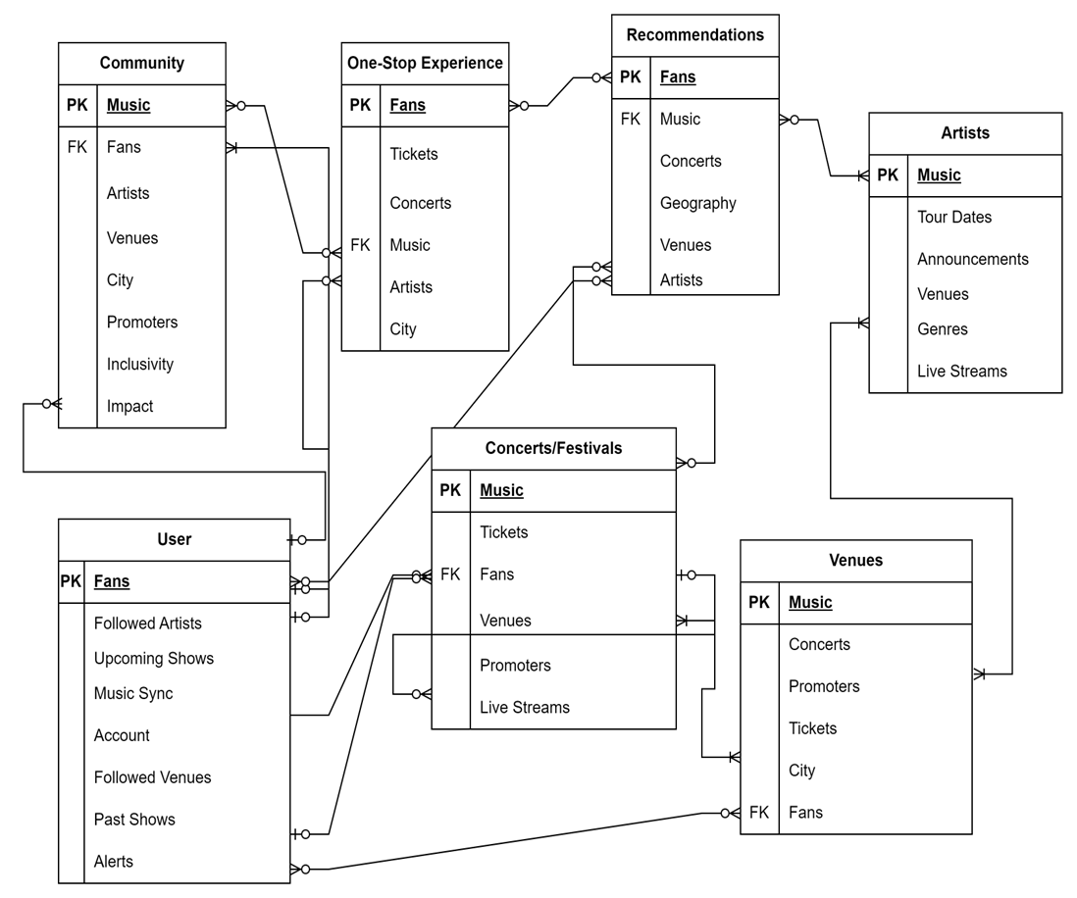
User Is The Centerpiece One-Stop Experience Table of 50 Rows
ER Diagrams

Slide 6
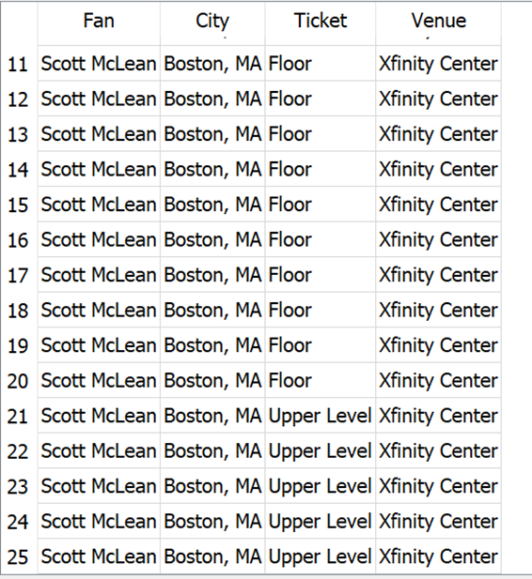
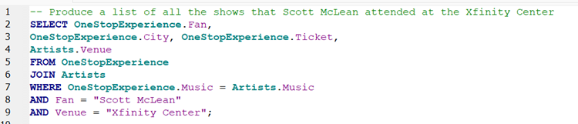
MAjor SQL examples
Code execution of all shows that fan Scott McLean attended at the Xfinity Center.

Slide 7
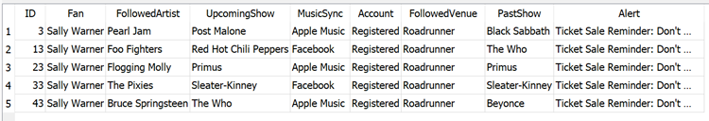
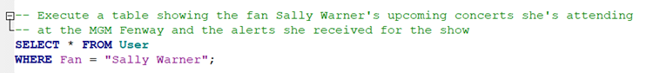
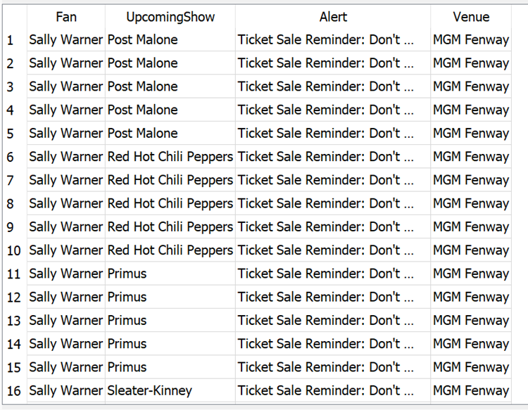

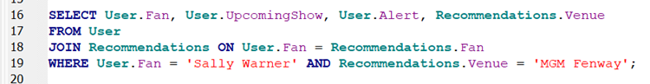
Major SQL EXamples (cont.)
Code execution of all upcoming shows that fan Sally Warner will be attending at the MGM Fenway and the alerts she receives.

Slide 8
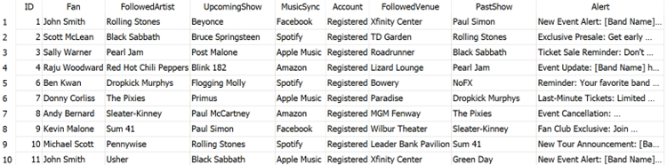
Major SQL Examples (Cont.)
Adjust model in response to changing music landscape.
Ask questions that pertain to stakeholder goals.

Slide 9

architecture
N-Tier Data Structure Implementation
Cloud Service Benefits (AWS or Google Cloud)
Scalability and Performance Considerations
Structuring for Efficiency and Business Execution

Slide 10
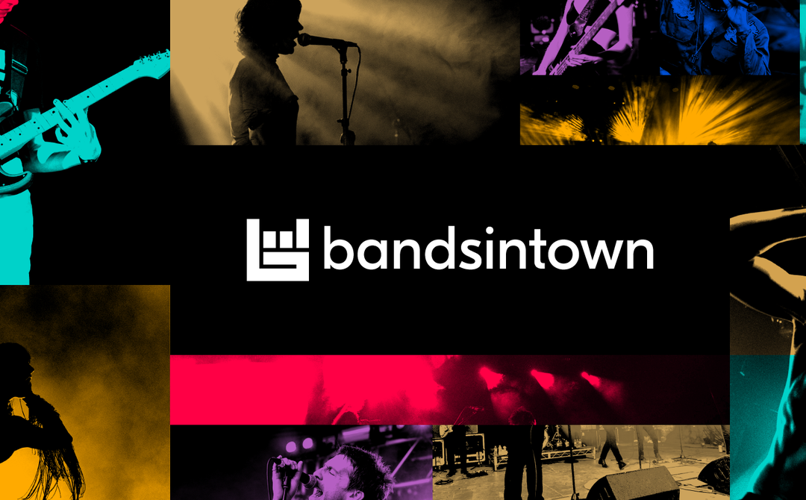
RECOMMENDATIONS & NEXT STEPS
UNDERSTANDING THE ROLE OF DATABASES EFFICIENT DATA RETRIEVAL WITH SQL SCALABILITY FOR FUTURE GROWTH

